Slide 1


QUICK SEAL SAVIOR
Redefining Emergency ResponseInnovations in High-Risk Environments

Slide 2
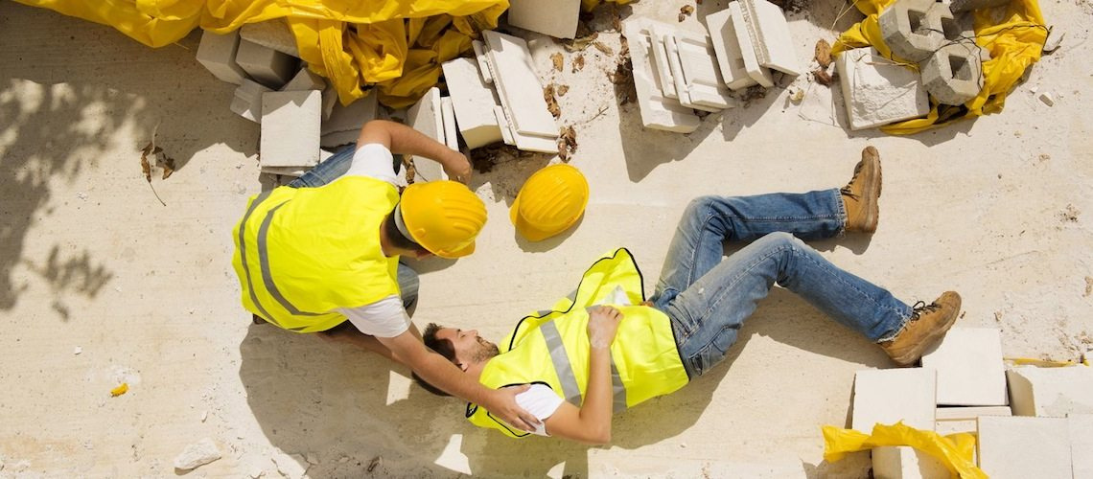
INTRODUCING QUICK SEAL SAVIOR: REVOLUTIONIZING EMERGENCY RESPONSE IN HARSH ENVIRONMENTS
Workers in high-risk industries face significant dangers, with over 2.3 million work-related deaths globally each year.
To introduce Quick Seal Savior and its transformative impact on emergency response.
Addressing critical gaps in emergency response in harsh environments.

Slide 3

PROBLEM DESCRIPTION
Challenges: Individuals in harsh environments face significant delays in accessing medical assistance, leading to heightened risks of injury escalation.
Importance: Proactive measures are essential in mitigating risks and ensuring timely intervention.
Statistics: Approximately 5.8 million people die each year due to injuries, with the majority occurring in low- and middle-income countries.

Slide 4

TECHNOLOGY OVERVIEW
Sensor Technology: Quick Seal Savior utilizes cutting-edge sensor technology to detect injuries and monitor vital signs.
Functionality: Sensors provide real-time data on heart rate, oxygen levels, and body temperature, enabling targeted intervention.
Advantages: Enhances situational awareness and enables prompt response to medical emergencies.
Statistics: Advanced sensor technology has the potential to reduce mortality rates from traumatic injuries by up to 50%.

Slide 5

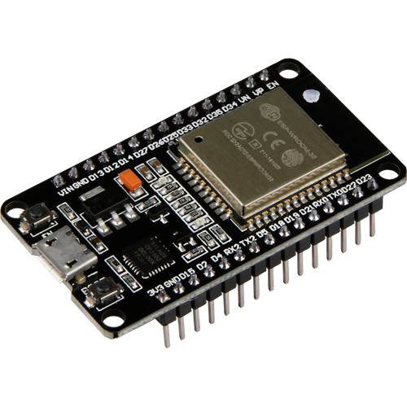
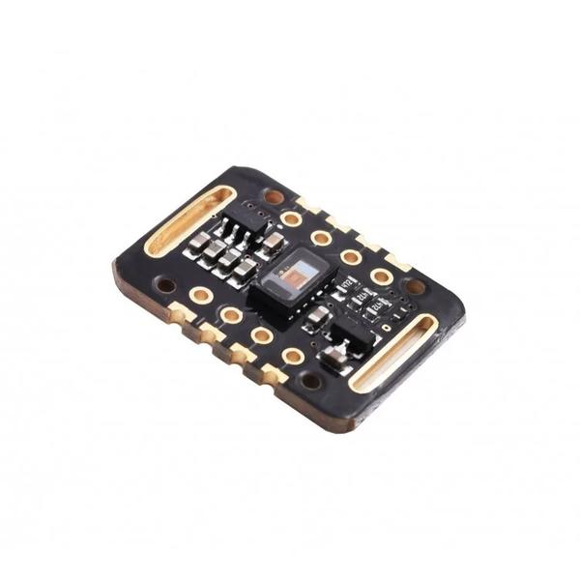
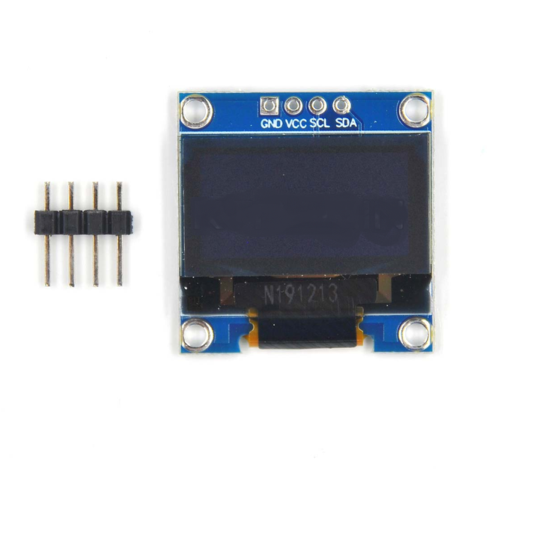
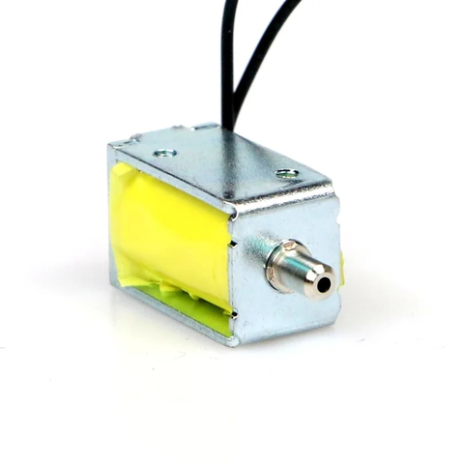
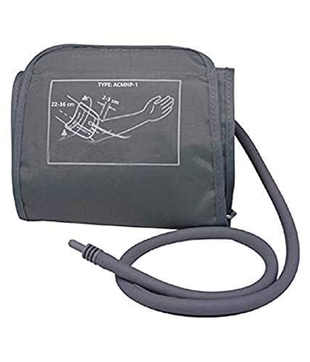
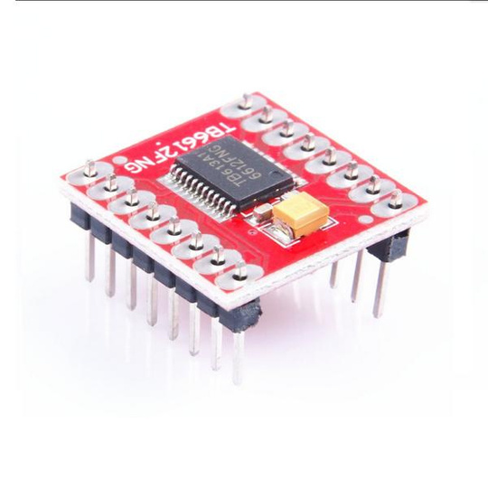
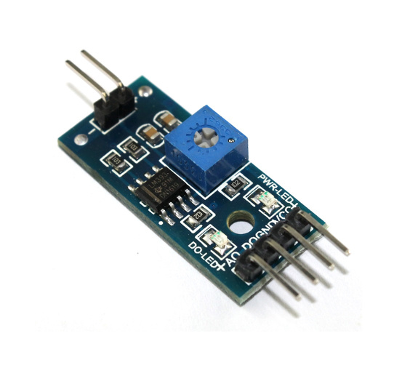
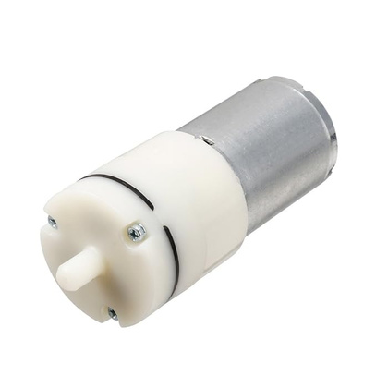
Components Used
Station 2:
Station 2:
Station 2:
Calculate the weight of an orange on different planets in our solar system.
ESP32 microcontroller
MAX30105 Pulse Oximeter Sensor
0.92-inch OLED Display
Solenoid Valve
Station 2:
Calculate the weight of an orange on different planets in our solar system.
Calculate the weight of an orange on different planets in our solar system.
Station 2:
Station 2:
Station 2:
Resistance-based Moisture Sensor
Blood Pressure Machine Cuff
Air Pump
Motor Driver TB6612FNG
Calculate the weight of an orange on different planets in our solar system.
Calculate the weight of an orange on different planets in our solar system.
Calculate the weight of an orange on different planets in our solar system.

Slide 6
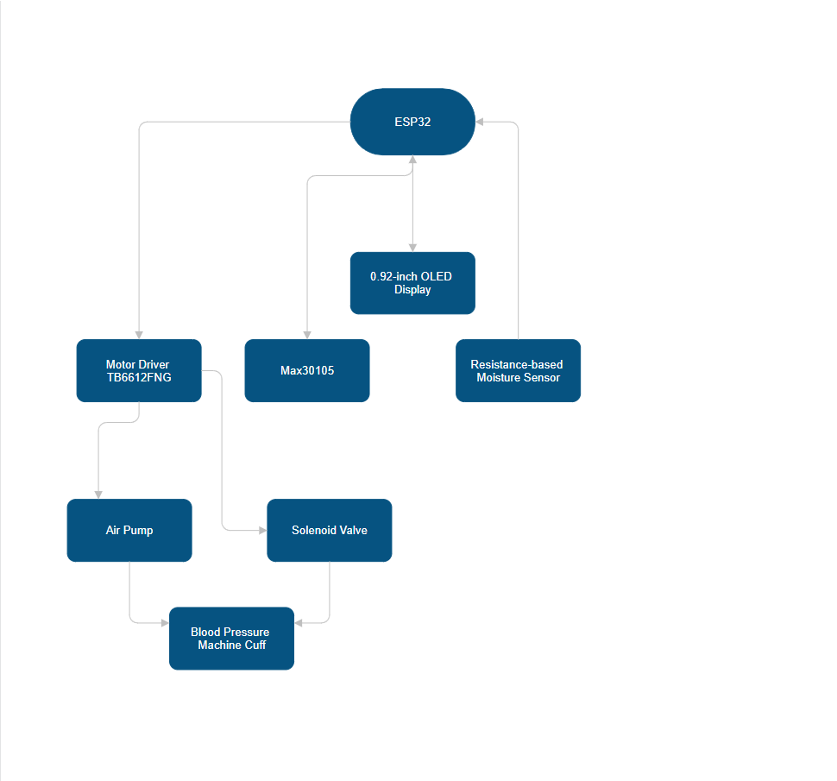

Slide 7
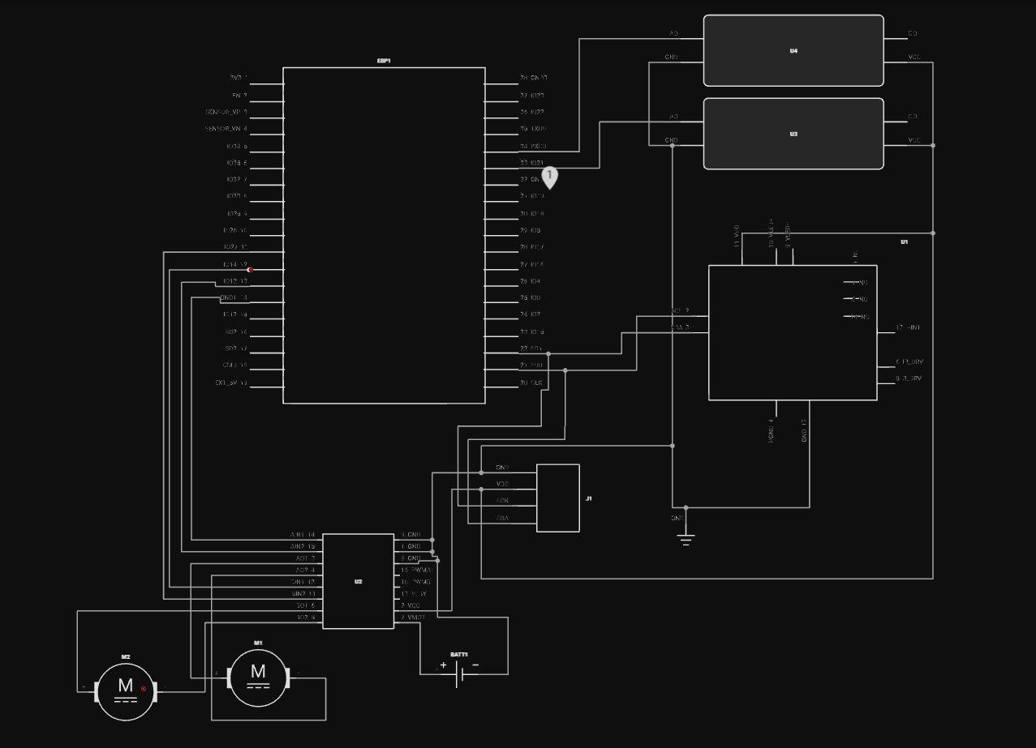

Slide 8
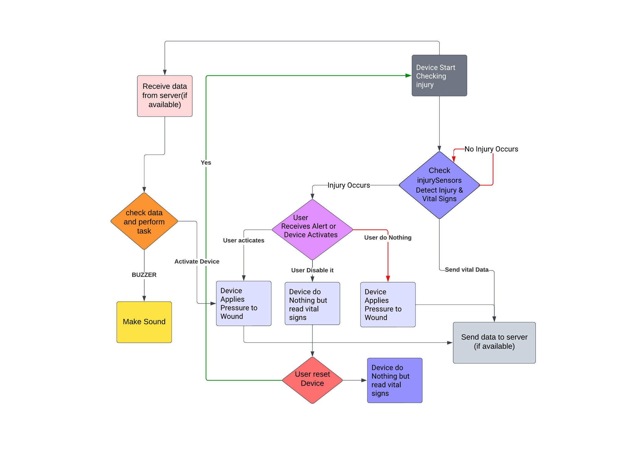

Slide 9

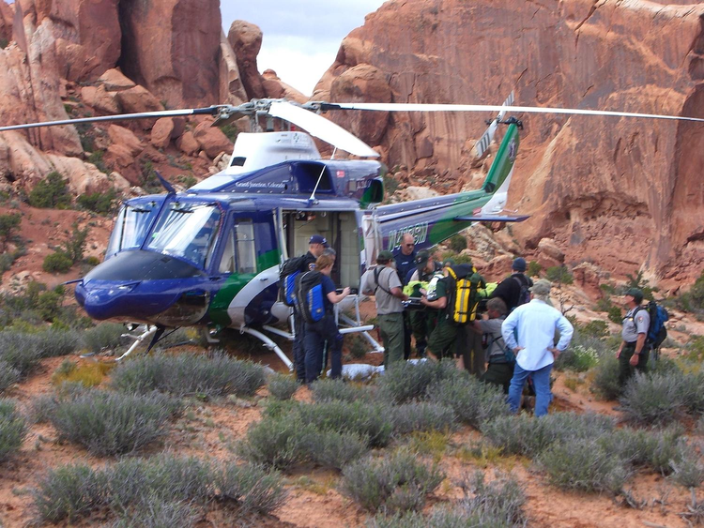
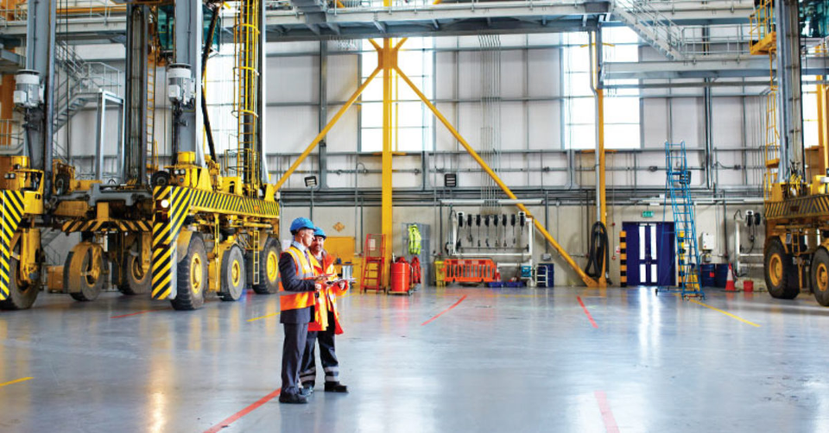
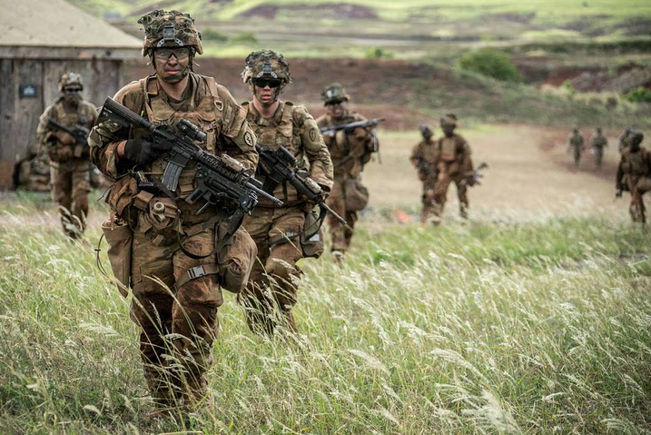
APPLICATIONS
Military Operations: Quick Seal Savior enhances the survivability of injured soldiers in combat zones.
Industrial Settings: Provides immediate assistance to workers in construction, mining, and oil and gas extraction industries.
Search and Rescue Missions: Facilitates rapid stabilization of injured individuals during disaster response operations.
Statistics: In disaster scenarios, up to 30% of deaths are due to uncontrolled bleeding, highlighting the need for rapid intervention.

Slide 10
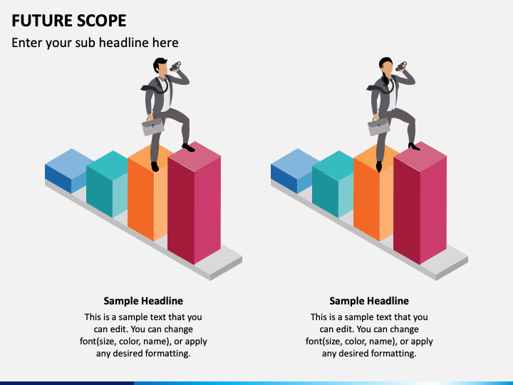
FUTURE SCOPE
Continuous Improvement: Emphasizes continuous improvement through research, innovation, and collaboration.
Expansion: Expanding applications of Quick Seal Savior in diverse industries and scenarios.
Global Impact: Maximizing the project's impact through equitable distribution and accessibility.
Statistics: Improved access to medical devices could save up to 1.5 million lives annually in low- and middle-income countries.

Slide 11
CONCLUSION
In conclusion, Quick Seal Savior represents a groundbreaking solution for enhancing emergency response in challenging environments. By leveraging advanced sensor technology and automated intervention capabilities, the project aims to save lives and mitigate the impact of injuries in high-risk scenarios. With a steadfast commitment to safety and innovation, Quick Seal Savior stands poised to revolutionize the way we approach medical emergencies, ensuring that individuals operating in the most demanding environments have the support they need to stay safe and secure. Our mission is to redefine emergency response and safeguard lives with Quick Seal Savior

